Slide 1
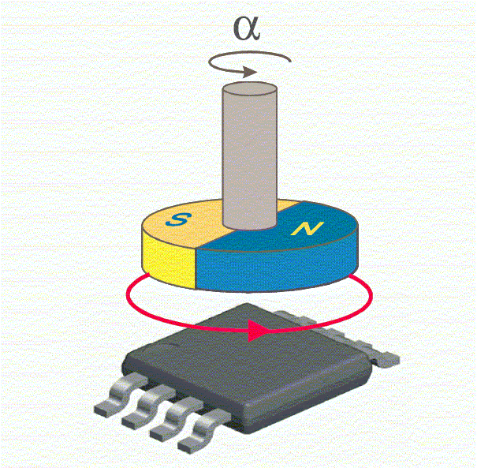
SE33 – Motor Sensor Selection Strategy
Description
End mounted motor position sensing
Two pole magnet
Application/Requirement dependent strategy
Motivation (Type:n)
<Provide rationale>
Deliverables
Selection Guide for Pursuits
Sensor Roadmap
Timing
Guide and roadmap for 2015/2016 Pursuits September 2015
Team Members/Customers
Team: Julie Kleinau, Steve Collier-Hallman, Ishtiaque Amin, Ken Sabol, Julius Woo, Karl Terauchi, Paul Fisher
Pursuit Team/PDTs

Slide 2
SE33 – Motor Sensor Selection Strategy
Status
Shared Google Sheet established with sensor characteristic comparisons including:
Technology, supplier, readiness, ability to meet Nexteer requirements, sensitivities, magnet and shunt ring requirements, latest cost book figures.
Challenges
Different applications have different or unique requirements.
Need for “turns counter” feature on some programs.
Varying requirements for redundancy on new programs.
Packaging constraints on end mounted sensor designs.
Next Steps
Complete population of data in shared Google Sheet and share with broader audience.
Condense relevant information into selection guideline.

Slide 3
Sensor Output Signal Selection
Sensors are available in multiple output types – how to choose?
Communication distance including single and multiple board configurations.
Primary motor position signal data rates are higher than tertiary or diagnostic signal only data rates.
“x” will vary based on data rate required. (Electrical group study and analysis underway).
SPI requires the highest data rate of the digital output choices.

Slide 4
Sensor Output Signal Selection
Convenience for integrated turns counter applications
Integrated Turns Counter feature is presently only packaged in digital output designs.
Cost/packaging
Analog sensors are usually the low cost solution for non-turns counter applications.

Slide 5
Magnet Type/Size/Shape
Type/Size/Shape is sensor technology dependent.
Shunt Ring required for Radial Field Sensing Technologies

